Slide 2


Port Security – Broadcast Storms

Slide 3

Port Security – Loop Prevention
Root Bridge
Notes:
STP

Slide 4



Port Security – BPDU Guard
Root Bridge
BPDU Guard
Bridge Protocol Data Unit
…...
Root ID
Cost
Bridge ID
Port ID
…...

Slide 5

Port Security – DHCP Snooping
DHCP
Discover
DHCP
Offer
Request
Acknowledge
Notes:
Trusted DHCP servers, drops messages from any DHCP message not received on any other port or drops Offer and Request messages received on different ports than the one that the discovery frame was received.

Slide 6


Port Security – MAC Filtering
Port 10
00-11-22-AA-BB-CC
Port 20
00-11-33-AB-CD-EF
Port 30
11-33-44-AB-DE-FF
??-??-??-??-??-??
??-??-??-??-??-??
00-11-22-AA-BB-CC
00-1-133-AB-CD-EF
11-33-44-AB-DE-FF

Slide 7

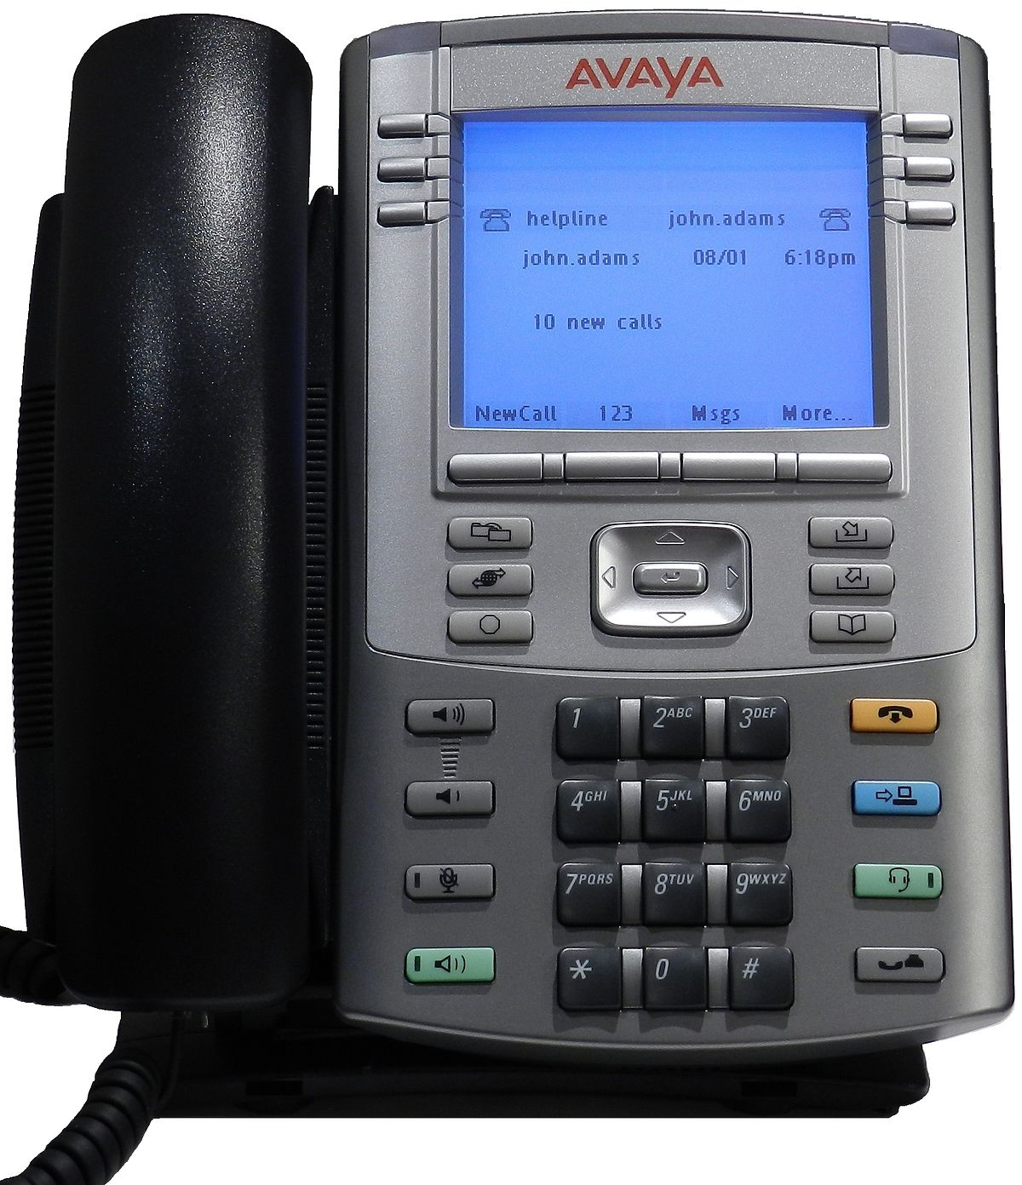
Port Security - Port Mirroring
PC 1
PC 2
PC 3
Monitor Station

